Slide 1
Modeling errors in physical activity data
Sarah Nusser Department of Statistics and Center for Survey Statistics and Methodology Iowa State University
Collaborators: N. Beyler, A. Carriquiry, W. Fuller, G. Welk

Slide 2
A brief tour through ideas
How do we frame the modeling problem to address public health questions?
Why is it important to use measurement error models?
How do we think about constructing statistical models that account for errors?
What do these models look like? How do you design a study to use them?
Unbiased activity measure
Biased activity measure

Slide 3
What is the relevant concept?
Many health outcomes are related to the long-term behavior of individuals, not what an individual did yesterday or last week
Long-term behavior is characterized by the usual activity for an individual
Usual Activity
An individual’s activity per unit time averaged over a long period of time
Notes:
Applies to any activity metric

Slide 4
Inference about whom?
Although usual activity is an individual-level metric, our focus is on public health questions
To address these questions, we need to characterize usual activity patterns for a group or population of individuals
Requires individual measurements on a (probability) sample of individuals from the pop.
From this, we can estimate pop. characteristics
% of population with inadequate activity
Relation between health outcome & usual activity

Slide 5
Basic approach
Use self-report activity data on a sample of individuals to make inferences about usual activity in the population
Because self-report activity data measure usual activity with error, we’ll need measurement error models to obtain inferences about usual activity in the population that are adjusted for error

Slide 6
What if we don’t adjust for error in self-report activity?
Biased estimates of correlation and regression coefficients
For correlation or a regression that uses self-reported activity as the only covariate, slope is attenuated
Bias not predictable in regression with more covariates than self-reported activity
Usual activity
Health outcome
24hr recall
Activity per unit time

Slide 7
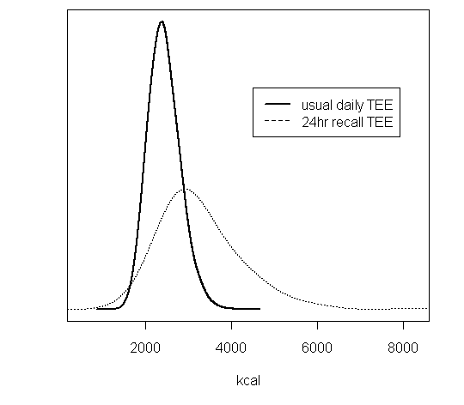
What if we don’t adjust for error in self-report activity?
Want to estimate average activity levels in the population?
If self-reported data are biased, estimated mean usual activity is biased
Want to estimate the percent of population with poor activity levels?
Extra variation in self-reported data cause the spread of distribution to be too wide, percentages are biased
_____ Usual activity
------- 24hr recall
kcal / d

Slide 8
Addressing errors in variables requires attention to design and analysis methods
“Right” measurement: data collected are related to the concept of interest (if possible)
“Good” measurement: protocol or question to generate accurate and precise measurements or responses
Prevention
Avoid error
Statistical models that include terms to describe systematic and random errors
Statistical designs that generate the kind of data required to estimate these parameters
Adjustment
Reduce impact of error

Slide 9
Sources of errors
Error framework used in statistical surveys to describe errors
Sampling error
Coverage (frame) error
Nonresponse error
Specification error
Measurement error
Processing error
Sample design and response process
Measurement and data generation process

Slide 10
Specification error
We are generally interested in collecting data on a specific concept (construct), even if we can’t always directly observe it
Example
Concept: usual daily activity
Measurement: activity yesterday (1 day)
Specification Error
Error that arises when our question or measurement method does not match the target concept

Slide 11
Measurement error
Examples
Respondent errors in recalling prior activities
Deliberate or subconscious over-reporting of time spent in vigorous activity
Mistakes in recording data
Measurement error
Error that arises in obtaining a response or measurement during data collection

Slide 12
Processing error
Examples
Assigning METs to self-reported activities
Criteria for classifying a behavior as MVPA or as sedentary
Proprietary processing algorithms applied to data from an activity monitor
Processing error
Error that is induced in manipulating the raw data to create analysis variables

Slide 13
Modeling errors in activity data
To illustrate concepts, we will consider some examples of models
Self-report: 24 hr recall
Activity metric: total energy expenditure
Target concept: usual daily energy expenditure

Slide 14
Target variable: usual daily activity (U) (… and some notation)
Usual activity of individual k = U_{k}
We’ll focus on the distribution of usual daily activity across individuals in population
Parameters for usual activity distribution
Mean usual activity for the population = μ_{U}
Person-to-person variation in usual activity = σ_{U}²
Notes:
This is the target variable we want to make inferences about
Describe the distribution notation using usual activity as the example

Slide 15
Modeling 24 hr recall data
24 hr recall for person k on day j = R_{kj}
Short-term recall data do not measure usual activity directly, but they are related to usual activity (specification error)
Self-report instruments also have some form of measurement (and processing) error
Some errors are random, varying from person to person or day to day
Other errors are systematic throughout the population, e.g., over-reporting activity

Slide 16
Simple model for 24 hr recall (R) and usual daily activity (U)
A 24 hr recall R is related, but not equal to usual activity U
Some model assumptions
R_{kj} = U_{k} + D_{kj}
 | Variable | Mean | Variance
Usual activty for person k | U_{k} | μ_{U} | σ_{U}² | Among person variance (variation from person to person)
Deviation of today’s activity from usual act. on day j for person k | D_{kj} | 0 | σ_{D}² | Within person variance (day to day variation for a person)
24 hr recall on day j for person k | R_{kj} | μ_{U} | σ_{U}² + σ_{D}² | Recall data include both types of variance
Notes:
This is a model for specification error
We can think of this a good model if the recall data were entirely accurate
D = today’s deviation from my long-run average
One issue with this model is that it assumes that recalls are unbiased for the true activity level

Slide 17
Simple model for 24 hr recall (R) and usual daily activity (U)
The among person variance for U can be estimated (i.e., separated from the within-person variance for D) if our design includes
2+ measurement days for subsample or all of the study sample to provide info on within-person variation
Model assumptions typically require independent days (e.g., separated by a few days or more)

Slide 18
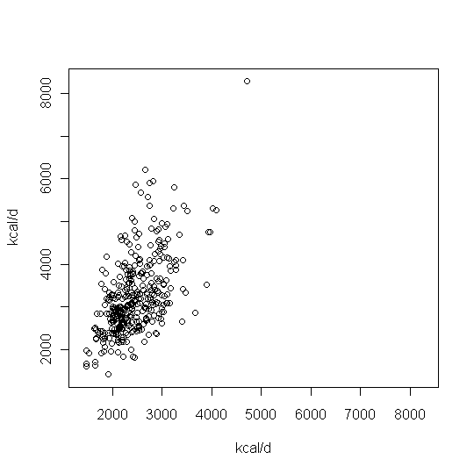
Self-report data may be biased
Example using early data from Physical Activity Measurement Survey (PAMS) (NIH grant)
Sample of Iowa adults
Concurrent observations on each sampled adult
24 hr recall of all activities
24 hr activity data from multi-sensor monitor
Women (21-70 yrs old)
Relationship if there is no bias in 24 hr recalls
Recall TEE (kcal/d)
Monitor TEE (kcal/d)

Slide 19
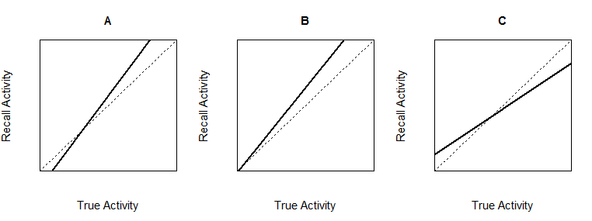
Accounting for population-level bias in self-reports
We can add an intercept and slope to express systematic reporting (& processing) bias in pop.
R_{kj} = β₀ + β₁ ( U_{k} + D_{kj} )
intercept
slope
Dashed line ---------
No systematic bias
β₀ = 0 and β₁ = 1
Solid line _____
Systematic bias present
β₀ ≠ 0 and/or β₁ ≠ 1
Under-report for low EE
Over-report for high EE
Always over-report
(proportional)
Over-report for low EE
Under-report for high EE

Slide 20
Some individuals are more accurate reporters than others
A person may have their own tendency to over- or under-report that is different from the population tendency
This is expressed as random variation across individuals in the pop. via the term S_{k}
R_{kj} = β₀ + β₁ ( U_{k} + D_{kj} ) + S_{k}

Slide 21
Random measurement errors
Finally, there are generally some additional unexplained deviations in a person’s reported activity on day j relative to their true activity
Random measurement error that varies from day to day for a person is expressed via E_{kj}
R_{kj} = β₀ + β₁ ( U_{k} + D_{kj} ) + S_{k} + E_{kj}

Slide 22
Some model assumptions
R_{kj} = β₀ + β₁ ( U_{k} + D_{kj} ) + S_{k} + E_{kj}
 | Variable | Mean | Variance
Usual activity for person k | U_{k} | μ_{U} | σ_{U}² | Among person variance (variation from person to person)
Deviation of today’s activity from usual act. on day j for person k | D_{kj} | 0 | σ_{D}² | Within person variance (day to day variation for a person)
Individual deviations in reporting bias for pers. k | S_{k} | 0 | σ_{S}² | Person-to-person variance in reporting bias
Measurement error for person k on day j | E_{kj} | 0 | σ_{E}² | Variation due to random measuremt & processing error
24 hr recall on day j for person k | R_{kj} | β₀ + β₁ μ_{U} | (β₁ ² σ_{U}² ) + (β₁ ² σ_{D}² ) + σ_{S}² + σ_{E}² | Recall data biased and include all types of variances
Notes:
Example from Iowa early data:
49% of recall variation is associated with person-to-person variation in UA
10% day-to-day variation
34% random deviations in bias (S)
7% unexplained measurement error
24 hr recall %
Usual TEE 0.705 0.49
Deviations 0.145 0.10
Indiv bias 0.486 0.34
ME 0.096 0.07

Slide 23
What does this model tell us?
The mean of the recall data may not be equal to the mean of the usual activity metric
Random variation in the recall data contains more than person-to-person variation in usual activity levels
Without adjustment, mean of recall data may over or under estimate usual activity mean
Without adjustment, variance of the recall data overstates true variation in usual activity

Slide 24
Design considerations
To estimate person-to-person usual activity variance, need replicate observations on at least subset of sampled individuals
To estimate systematic bias in self-reports, need a second unbiased measurement (M) (e.g., multisensor monitor) as a benchmark
Measurement error models for monitor M & recall R
M_{kj} = ( U_{k} + D_{kj} ) + F_{kj}
R_{kj} = β₀ + β₁ ( U_{k} + D_{kj} ) + S_{k} + E_{kj}

Slide 25
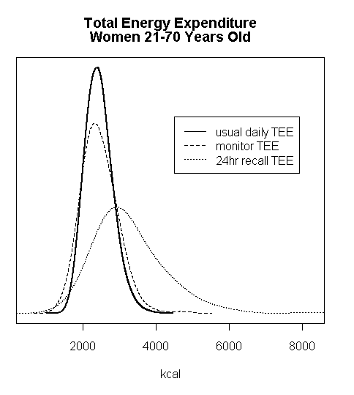
Estimated total energy expenditure distributions (Early PAMS data)
24 hr recall
Over-reporting bias
Over-dispersion
24 hr multi-sensor monitor
Benchmark to adjust for over-reporting
Still has extra variation
Usual activity
Unbiased estimate of mean
Proper spread of distribution
kcal / d

Slide 26
Back to the relationship between health outcomes and activity
With this model, we can estimate attenuation factor associated with recall data for adjusting correlation
We can also generate predicted usual activity values for individuals to use in regressions (these are poor estimates of individual usual activity, but have appropriate mean and variance at population level)
Usual activity
Health outcome (heart rate)
24hr recall
Activity per unit time

Slide 27
Summary
A few examples of measurement models and study designs to adjust self-reports for errors
Use understanding of the errors to build the model
Develop study design to support model estimation
With model, can obtain estimates that reflect properties of usual activity in the population
Usual activity distribution: appropriate mean and variance (bias removed)
Regression: obtain unbiased estimates of relationship between activity and health outcome

