Slide 1
A Legal Research Perspective
NCCOR/RWJF Research Roundtable III:
Food Advertising and Marketing to Children and Youth
_{Samantha Graff}
_{NPLAN Legal Research Director}
_{sgraff@phlpnet.org}
_{April 5, 2011}

Slide 2
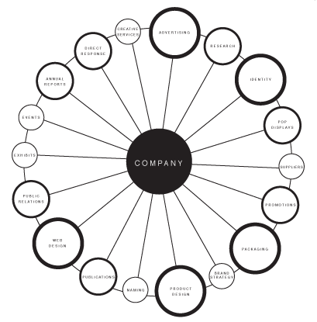
Integrated Marketing Communications
everything is marketing
Marketing Communications
Notes:
Any effort or communication that directly or indirectly incites product consideration and/or purchase.

Slide 3
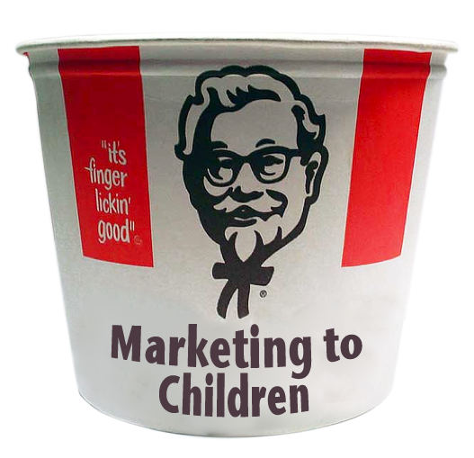
the First Amendment
provides protection for advertising
other marketing practices
advertising
Notes:
Advertising—commercial speech—gets more protection; government has to jump through more hoops
What is advertising: “Speech proposing a commercial transaction”—billboards, TV ads, magazine ads
Regulations of other marketing practices: zoning, transfat, sampling, soda tax, portion size, toy giveaway—which ones effective?

Slide 4



what is advertising?
©aboutmcdonalds
Notes:
Fuzzy distinction in IMC world: sponsorship; end of aisle displays; advergames?
Best thing for those who want to restrict junk food marketing to kids is to classify as much as possible as business practices.
But if it is advertising, that’s not the end of the story.

Slide 5
what advertising is unprotected?
unprotected
advertising for unlawful activities
false advertising
actually or inherently misleading advertising
protected
non-misleading advertising
potentially misleading advertising
Notes:
Actually or inherently misleading: proven to be misleading in practice or more likely to deceive the public than inform it
Examples of unprotected misleading speech
Use of “board certified” to mean something different than certified by state medical board
Use of geographically inaccurate wine names and labels
Use of subliminal messages
Advertising to children: actually or inherently misleading? If so, can be regulated all or in part.
Note: even protected advertising can be regulated if the government has a really good reason and the regulation is well tailored to fit the problem.

Slide 6
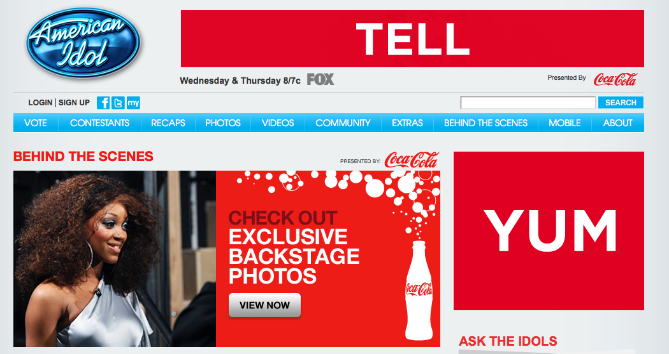
what is advertising to children?
Notes:
Define age: Ask people what age?
Define media
Percent of audience: America Idol problem
Content of ad
Programming content
FTC and CFBAI have guidelines but if used for regulations, need to be backed by evidence

Slide 7
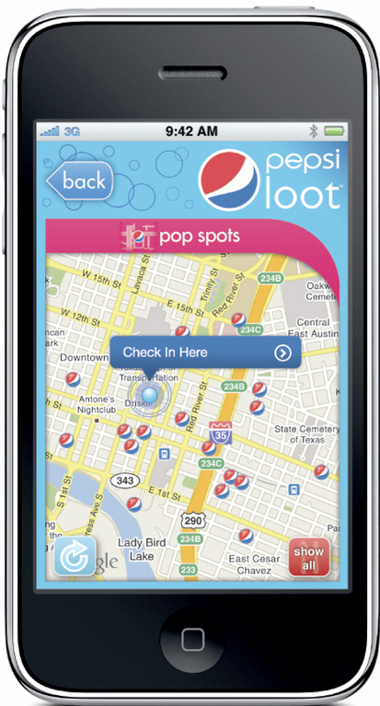
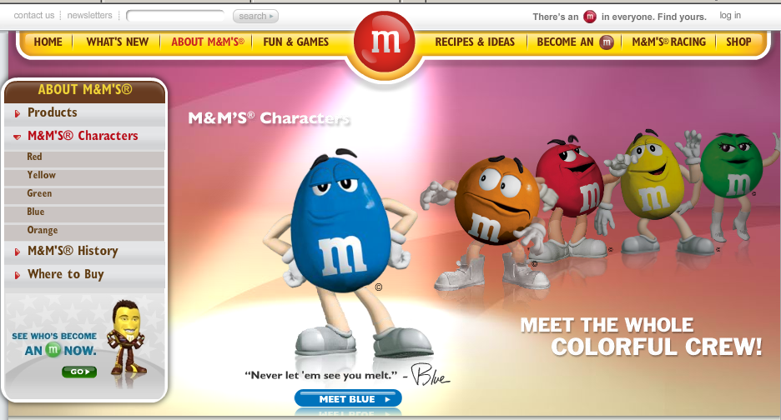
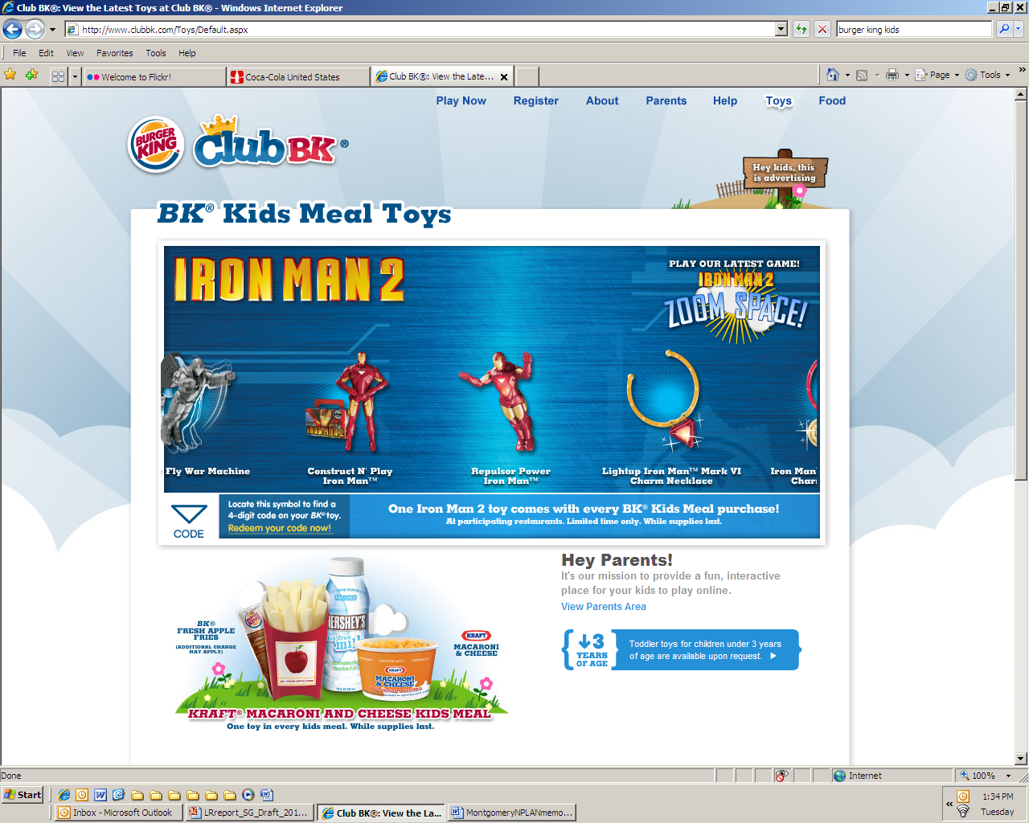
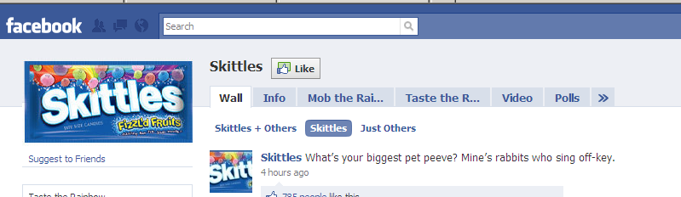
what marketing techniques are
misleading?
Notes:
Techniques: immersive augmented reality, social media, data collection and profiling, location targeting, neuromarketing
Federal and state consumer protection law—outlaws ads likely to mislead a reasonable consumer in a material way (often with unfairness)
Misleading examples that FTC pursued
Finding: Toy company engaged in unlawful practice when commercial showed Robot responding to voice commands when it couldn’t do so
Allegation: Program length commercial designed to look like investigative news program
Warning letter: Baby Einstein claims that videos were educational with no research behind claims
FTC guidance on disclosing material connections between advertisers and endorsers

Slide 8
how can you help?
research topics
explore promising non-speech marketing restrictions
build the case for protecting children from harmful food marketing
identify misleading techniques
  http://www.nplanonline.org/childhood-obesity/products/food_marketing_FTC
  http://www.nplanonline.org/childhood-obesity/products/State-AGs
Notes:
Non-speech restrictions: easiest from a legal perspective
Build the case: effect of ads on children, link between ads and consumption and obesity, what’s being advertised, what’s going on with self-regulation, etc.
Misleading techniques
Claims about the health benefits or other product characteristics that are not true or not supported by studies
Sales tactics that take advantage of children’s lack of cognitive ability, experience, and sophistication
Marketing that pretends to be something else
Disclaimers or disclosures that are not likely to be effective for children or teens
Marketing that takes advantage of children’s social relationships
Marketing that sidesteps parental decision-making and control
Marketing that invades a child’s privacy or puts a child at risk, such as marketing that takes into account a child’s physical location and/or detailed personal

Slide 9

Public Health Law & Policy
We partner with state and local leaders to improve health in all communities, especially the underserved.
We do this by researching legal and policy questions, drafting policy language, and training community leaders to put these ideas to work.
Notes:
9

Slide 10
Disclaimer
The information provided in this seminar is for informational purposes only, and does not constitute legal advice. Public Health Law & Policy does not enter into attorney-client relationships.
The primary purpose of this training is to address legal and/or policy options to improve public health. There is no intent to reflect a view on specific legislation. PHLP incorporates objective non-partisan analysis, study, and research in all our work.

