Slide 1
Collaborating with NCCOR
Presented By: Todd Phillips

Slide 2
NCCOR Goal Areas
Goal 1: Identify and evaluate effective interventions, with an emphasis on those that affect vulnerable populations and communities.
Goal 2: Increase and improve national, state, and local surveillance of childhood obesity.
Goal 3: Increase ability of childhood obesity researchers and program evaluators to conduct research and program evaluation.
Goal 5: Work with non-health partners to integrate childhood obesity priorities with synergistic initiatives (e.g., environmental design and sustainability, food systems, food marketing, disabilities, or economics).
Goal 4: Provide national leadership to accelerate implementation of evidence-informed practice and policy.

Slide 3
www.nccor.org

Slide 4
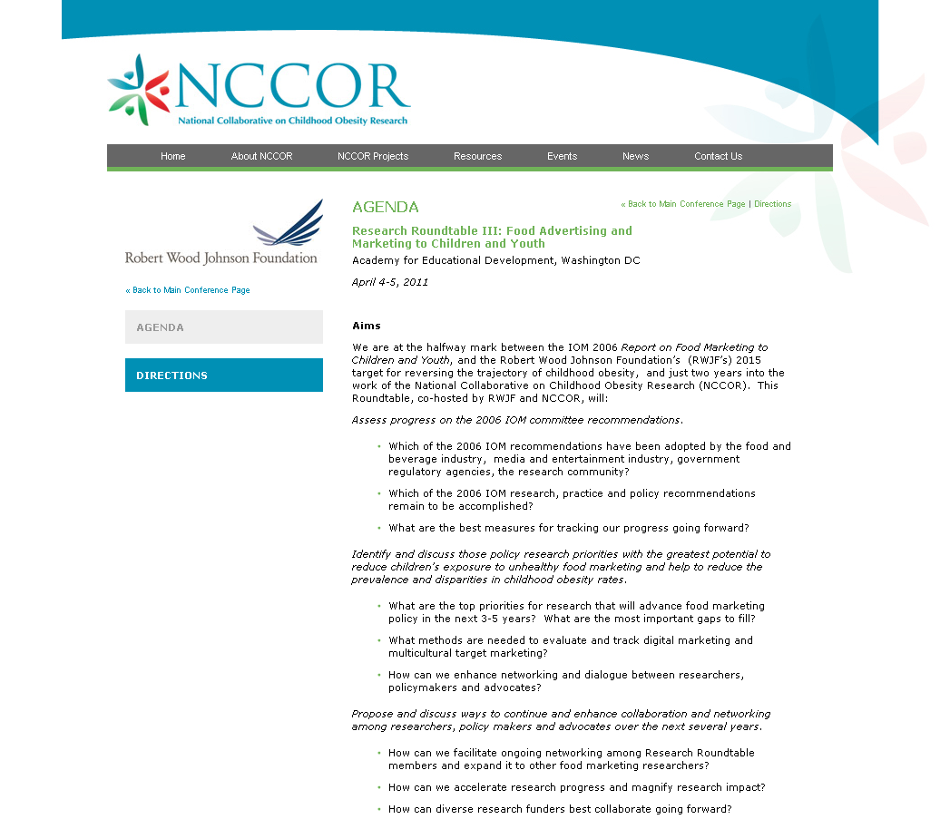
Research Roundtable III: Food Advertising and Marketing to Children and Youth

Slide 5
NCCOR e-Newsletter
Spotlight
Publications & Tools
Research Highlights
Childhood Obesity News
Funding Opportunities
Sign up at: www.nccor.org/e_newsletter.html

Slide 6
Upcoming Webinars
Hand in Hand, Together We Can: Working with
Communities to Improve America's Health Webinar
Series (March 10, 2011)
Healthier Food for Revitalized Communities (March
24, 2011)
Catalogue of Surveillance Systems (May 5, 2011)
Measures Registry (May 19, 2011)
Junk Food Marketing to Kids: Can We Stop It? (May
26, 2011)
Pricing for Health: How to Make the Healthy Stuff
Cheaper (June 23, 2011)
Healthier Corner Stores: Finding the Funding (July
28, 2011)

Slide 7
Todd Phillips, Director
tphillip@aed.org

