Slide 1
Food Marketing to Children and Youths: Evidence from the Bridging the Gap Program
Research Roundtable III: Food Advertising and Marketing to Children and Youth
Academy for Educational Development, Washington DC, April 5th 2011
April 4-5, 2011
Lisa M. Powell, PhD
University of Illinois at Chicago

Slide 2
Bridging the Gap is…
A collaborative effort to assess the impacts of policies, programs & other environmental factors on a variety of adolescent health-related behaviors
An RWJF initiative begun in 1997 with focus on adolescent alcohol, tobacco, and other drug use and related outcomes
More recently expanded to include youth eating practices, physical activity, and weight outcomes
Linked to the ongoing, NIDA-funded, Monitoring the Future study

Slide 3
University of Michigan
Lloyd Johnston, Project Director
Institute for Social Research
Monitoring the Future (MTF)
Youth, Education and Society (YES!)
University of Illinois at Chicago
Frank Chaloupka, Project Director
Health Policy Center
ImpacTeen
Food & Fitness

Slide 4
PI: Frank Chaloupka
Co-Investigators and key staff include: Lisa Powell, Jamie Chriqui, Lindsey Turner,
Dianne Barker, Leah Rimkus, Sandy Slater Sherry Emery, Glen Szczypka, Lisa Nicholson,
Dan Taber, Roy Wada, Jidong Huang, Rebecca Schermbeck, Anna Sandoval, and others…….

Slide 5
Bridging the Gap - Obesity
State and National
Annual collection of state policies and commercial data (UIC)
Local and Community
Planned annual community data collection and ongoing district wellness policy collection and coding (UIC)
National food and beverage television advertising
State level policies addressing the built environment
Availability and accessibility of physical activity opportunities
School and Organizational
Annual YES (ISR-UM) and
Food & Fitness surveys (UIC)
Local zoning codes, regulations, and ordinances that can impact on healthy eating and physical activity
Marketing of food/beverages at school
Comprehensiveness of school district wellness policies
Individual and Household
State level policies and legislation around Safe Routes to School
Presence and content of vending machines at school
Annual MTF surveys (ISR-UM)
Commercial data (UIC)
Market-level PSAs related to healthy eating, physical activity, and obesity
Availability of various foods/beverages in the school environment
Self-reported height and weight, physical activity,
and measures of healthy eating
Household food expenditures
Information on healthy eating and physical activity opportunities from key informant interviews
Marketing of healthy/unhealthy foods and beverages in communities
Frequency and length of physical education and recess
Awareness and implementation of Alliance for a Healthier Generation Guidelines
Implementation of school district wellness policies
State taxation of beverages, snack foods, and restaurant food
State policies related to healthy eating and physical activity
Availability and accessibility of healthy food and beverages in stores and restaurants
Characteristics of the built environment that impact on physical activity
State policies related to school district wellness policies

Slide 6
Bridging the Gap data include …
Monitoring the Future Surveys of adolescents
Household food purchases (HomeScan)
Surveys of primary and secondary school administrators
School district wellness policies
Community-level observations
Community-level ordinances and regulations
Market and national level television advertising exposure
State-level policies and regulations
Variety of archival data

Slide 7
Children’s Exposure to Food-related Advertising on TV
Nielsen Media Research Ratings Data

Slide 8
Advertising Data
Advertising Data
Targeted Ratings Points (TRPs) data on exposure to ads seen on TV obtained from Nielsen Media Research
Ratings cover all programming seen by children
Ratings points measure the reach and frequency of advertising. For example, a commercial with 80 TRPs for 2-5 year olds per month is estimated to have been seen an average of one time by 80% of children 2-5 over the defined period
Ratings by:
Year: 2003, 2005, 2007, and 2009
Age Groups: 2-5y, 6-11y, and 12-17y
Race: All children, separately by white and black. Study does not include separate ratings for Hispanic children nor does it cover Spanish Language TV
Food-related advertising categorized as:
Cereal, Sweets, Snacks, Beverages, Fast Food Restaurants, Full-service Restaurants, and Other

Slide 9
Number of Food-Related Ads Per Day, By Year and Age
Advertising Content
Food-Related | 2003 | 2005 | 2007 | 2009 | % Change 2003-2009
Children Age 2-5 | 13.3 | 12.1 | 11.5 | 10.9 | -17.9%
Children Age 6-11 | 13.6 | 13.5 | 13.1 | 12.7 | -6.9%
Adolescents Ages 12-17 | 13.1 | 13.4 | 13.6 | 14.5 | 10.4%
Food & Bev Products | 2003 | 2005 | 2007 | 2009 | % Change 2003-2009
Children Age 2-5 | 10.1 | 8.7 | 7.9 | 6.8 | -32.5%
Children Age 6-11 | 10.1 | 9.7 | 8.9 | 7.9 | -21.7%
Adolescents Ages 12-17 | 8.8 | 8.5 | 8.2 | 8.4 | -4.4%
Fast Food | 2003 | 2005 | 2007 | 2009 | % Change 2003-2009
Children Age 2-5 | 3.2 | 3.3 | 3.6 | 4.1 | 28.7%
Children Age 6-11 | 3.5 | 3.8 | 4.2 | 4.8 | 35.4%
Adolescents Ages 12-17 | 4.4 | 4.9 | 5.5 | 6.1 | 40.4%

Slide 10
Exposure to Food Advertisements per Day for Children by Year
Advertising Content

Slide 11
Exposure to Food Advertisements per Day for Children by Year
Advertising Content

Slide 12
Exposure to Food Advertisements per Day for Adolescents by Year
Advertising Content

Slide 13
Nutritional Content Analysis
Nutritional Content
Food and beverage advertisements were assessed on the basis of:
Saturated Fat (% Kcal): High >10% Kcal from saturated fat
Sugar (%Kcal): High >25% Kcal from sugar
Sodium (mg per 50g portion): High >200mg of sodium per 50g portion
Fiber (g per 50g portion): Low <1.15g of fiber per 50g portion
Nutritional Content was weighted by the ratings data to provide estimates of exposure to nutritional content

Slide 14
Food Ads High in Saturated Fat, Sugar or Sodium Children Ages 2-5 Years
Nutritional Content

Slide 15
Food Ads High in Saturated Fat, Sugar or Sodium Children Ages 6-11 Years
Nutritional Content

Slide 16
Food Ads High in Saturated Fat, Sugar or Sodium Adolescents Ages 12-17 Years
Nutritional Content

Slide 17
Number of Ads Seen and Nutritional Content (%) of Ads for CFBAI vs. Non CFBAI Companies
Nutritional Content
 | # of Ads per Day |  |  | % of Ads High in SFSUSO
 | 2003 | 2009 | % Change 03-09 | 2003 | 2009 | % Change 03-09
Age 2-5
CFBAI Companies Food and Beverage Products Subtotal | 8.7 | 5.4 | -37.5% | 94.0% | 88.2% | -6.2%
Non CFBAI Companies Food and Beverage Products Subtotal | 1.4 | 1.4 | -1.3% | 93.3% | 79.0% | -15.3%
CFBAI Fast Food Companies Subtotal | 1.2 | 1.3 | 4.9% | NA | NA | NA
Non CFBAI Fast Food Companies Subtotals | 1.1 | 1.5 | 38.8% | NA | NA | NA
Age 6-11
CFBAI Companies Food and Beverage Products Subtotal | 8.6 | 6.4 | -25.2% | 93.6% | 88.2% | -5.8%
Non CFBAI Companies Food and Beverage Products Subtotal | 1.6 | 1.5 | -2.2% | 93.6% | 79.4% | -15.2%
CFBAI Fast Food Companies Subtotal | 1.2 | 1.5 | 27.9% | NA | NA | NA
Non CFBAI Fast Food Companies Subtotals | 1.5 | 1.9 | 33.1% | NA | NA | NA

Slide 18
Summary: Results of CFBAI Companies
Nutritional Content
General Mills remains the largest advertiser; moderate reduction in ads seen by 2-5y (-16%) and an increase for 6-11y (6%). 97% of ads seen are for unhealthy products.
Kellogg and Kraft ads are both down by about 40-50% for children, but about 9/10 ads still seen are for unhealthy products.
Coke ads are down substantially (-57%), only company other than Cadbury with less than 50% of ads for unhealthy products.
Pepsi ads down substantially (-70%), although 82% remain for unhealthy products.
Overall, there were significantly fewer food and beverage product ads seen by children from CFBAI companies (-38%) compared to the 1% reduction in non-CFBAI food companies. But that the vast majority of the CFBAI company ads (88%) seen, in 2009, continued to be for products that were high in either saturated fat, sugar or sodium.

Slide 19
General Summary of Trends in Ad Content
Summary and Policy Implications
Positive reductions in exposure to food and beverage ads from 2003-09:
-33%, -22% and -4% for 2-5y, 6-11y and 12-17y olds, respectively
Cereal: -30% for 2-5y; -11% for 6-11y
Sweets: -55% for 2-5y; -44% for 6-11y
Snacks: -43% for 2-5y; -32% % for 6-11y
Beverages: -43% for 2-5y; -41% for 6-11y
But fast food ad exposure up substantially between 2003 and 2009:
+21%, +31% and +37% for 2-5y, 6-11y and 12-17y olds, respectively
The vast majority of ads seen in 2009 continue to be for products that are either high in saturated fat, sugar, or sodium:
86%, 87% and 81% of ads seen by 2-5y, 6-11y and 12-17y olds, respectively

Slide 20
Policy Implications of Trends in Ad Content
Summary and Policy Implications
Children, on average, continue to see more than 10 food-related ads on TV every day (teens see almost 15 ads per day)
Children and teens continue to be exposed mainly to food and beverage ads for products that are high in saturated fat, sugar or sodium
Study results suggest that industry self-regulation is limited in its effectiveness to substantially improve food-related advertising seen by children on TV
Key issues of concern for policymakers regarding CFBAI self-regulation:
No uniform nutritional standards
No uniform definition of child audiences
Does not address reach of ads in non-child programming
Does not apply to children age 12 and over

Slide 21
Community Obesity Measures Project: Food Marketing Measures

Slide 22
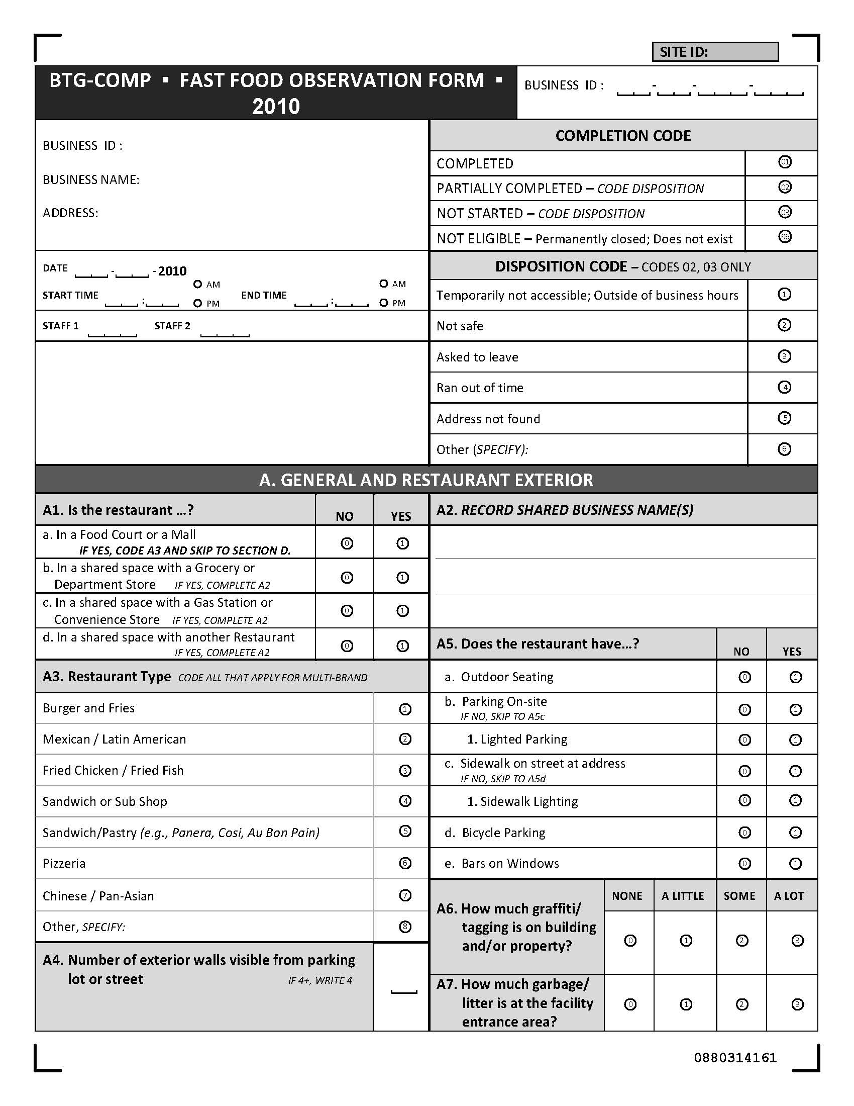
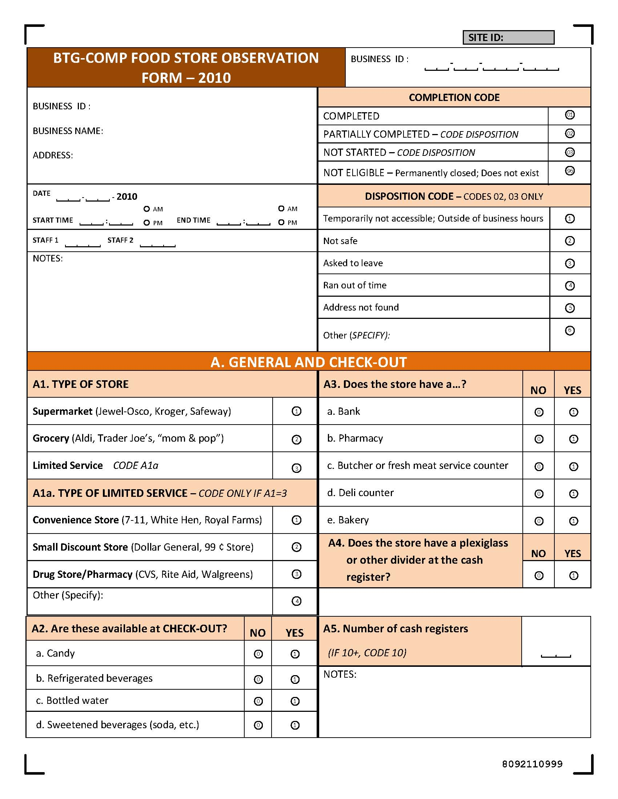
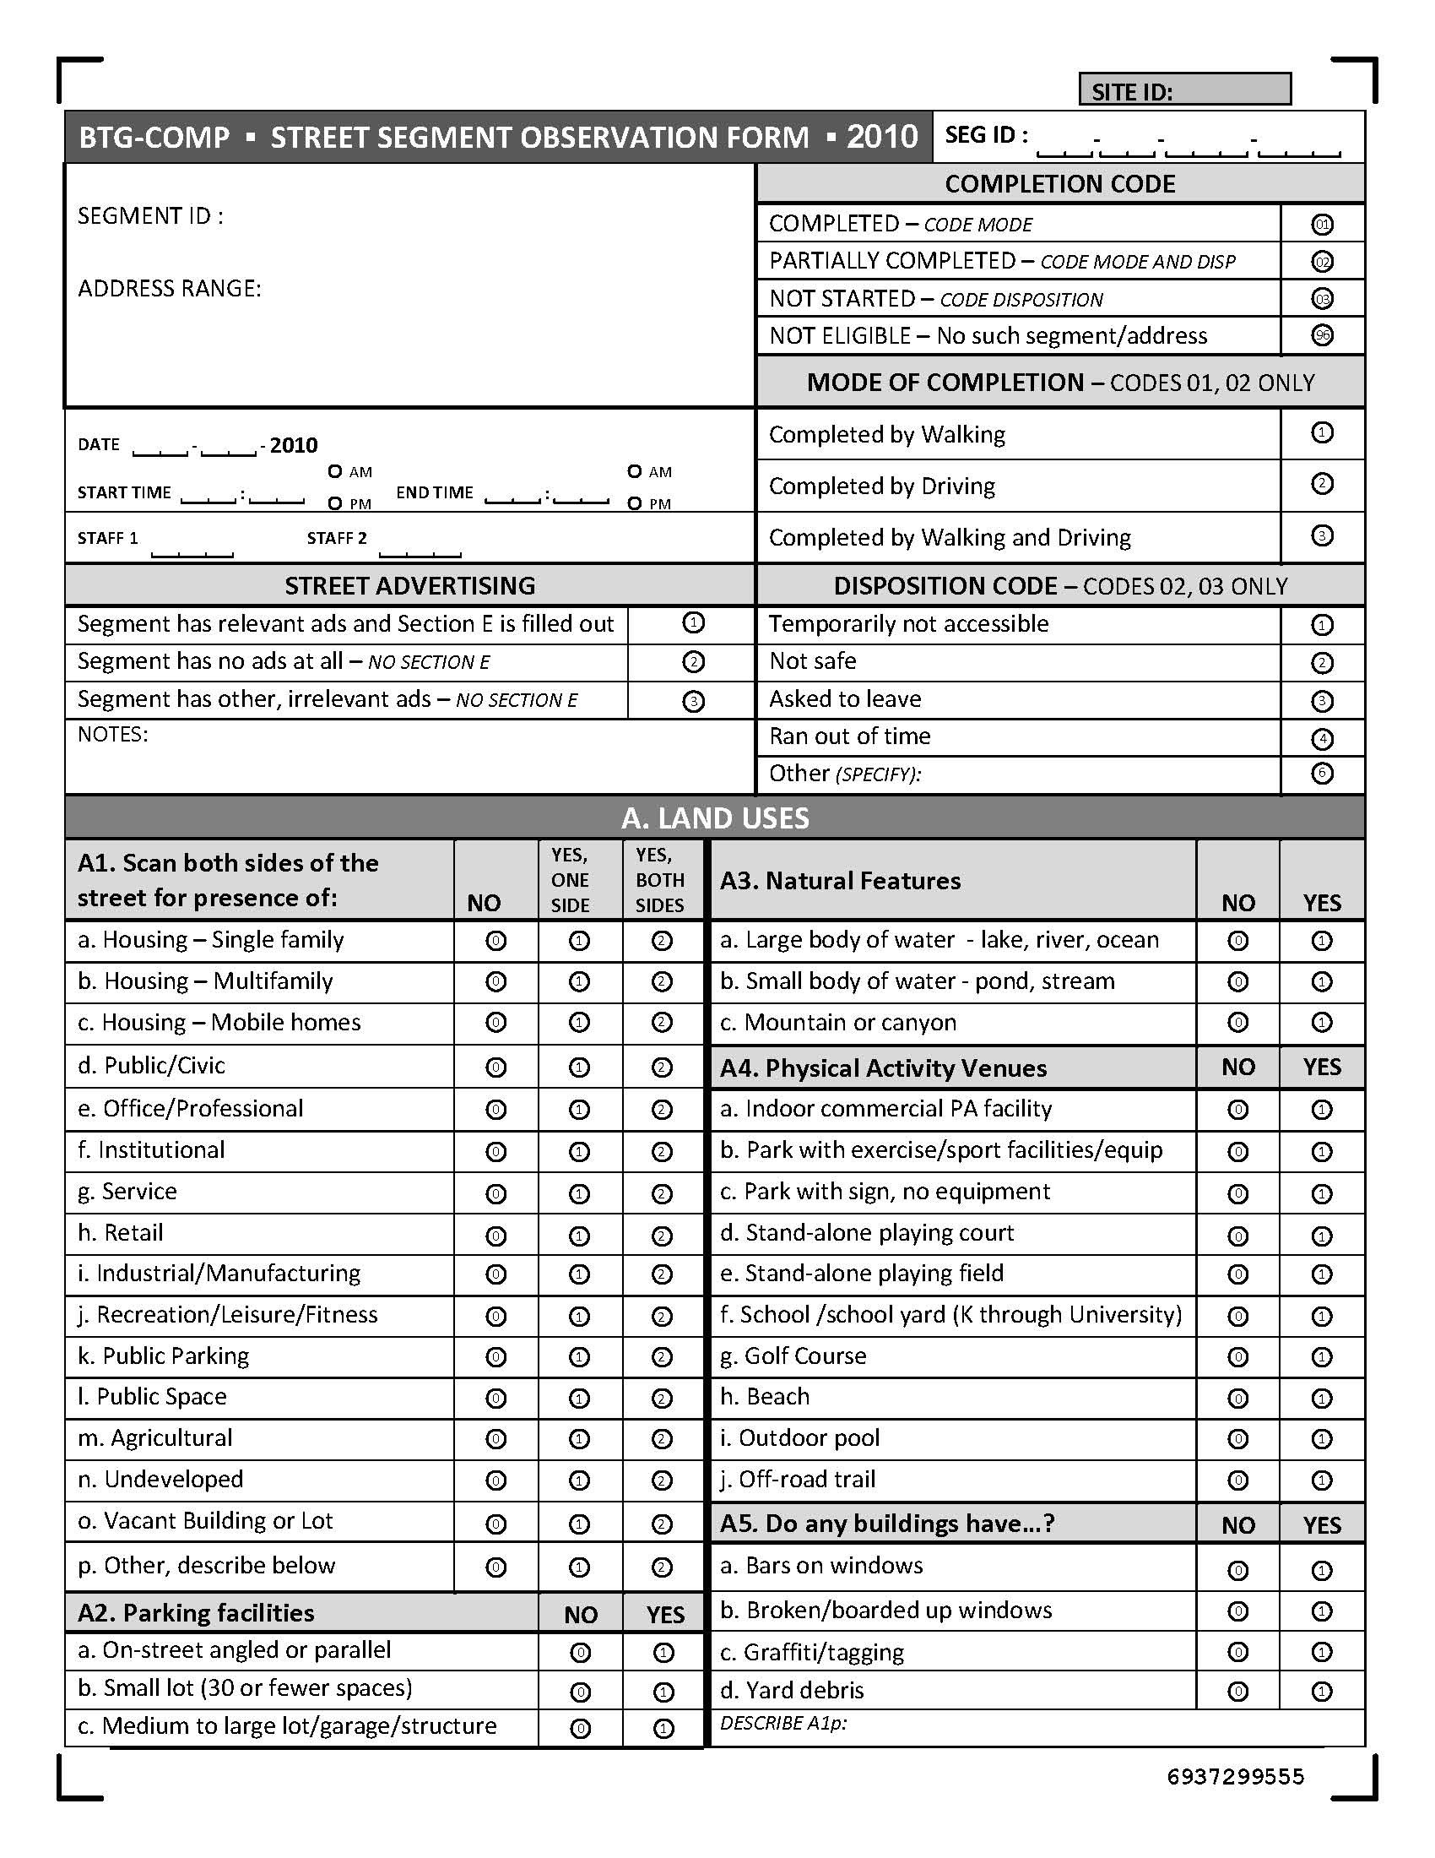

Slide 23
Food Environment Measures
Observational data collection
Food stores (supermarkets, grocery stores, convenience stores, gas stations, drug stores, dollar stores)
Fast food restaurants
Measures and indices constructed
Availability, placement, pricing and quality of select food and beverage products and tobacco products
Food/beverage and tobacco advertising
Nutrition information

Slide 24
Physical Activity Environment Measures
Observational data collection
Fitness centers (YMCA, B&G Clubs, JCCs, Commercial)
Community recreation centers and parks
PA Instructional schools (e.g., karate, dance)
Street segments
Measures and indices constructed
Availability and quality of facilities; pricing
Safety, amenities, aesthetics
Walkability, bikability

Slide 25
Policy Environment Measures
Local policy collection and coding:
Local ordinances and codes
Local zoning policies
Community master plans
Local taxes on soda and candy
School district wellness policies and joint use agreements
Menu labeling requirements
Restrictions on fast food, formula restaurants

Slide 26
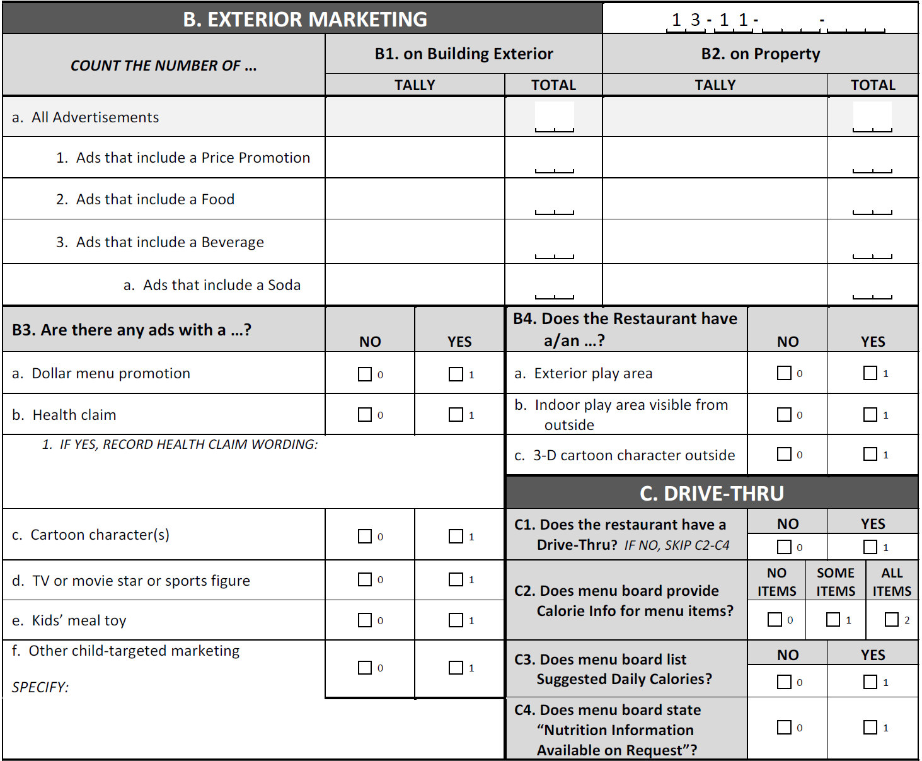
BTG-Comp: Fast Food Observation Form 2011

Slide 27
Preliminary Results: 2010 Data BTG-Comp: Fast Food Observation
B. EXTERIOR MARKETING
COUNT THE NUMBER OF … | B1. % of Outlets with Advertisements on Building Exterior | B2.% of Outlets with Advertisements on Property
a. All Advertisements | 72.7% | 37.6%
1. Ads that include a Price Promotion | 49.9% | 26.0%
2. Ads that include a Food | 67.8% | 31.3%
3. Ads that include a Beverage | 41.0% | 17.2%
a. Ads that include a Soda | 20.4% | 9.0%
B3. Are there any ads with a …? | YES
a. Dollar menu promotion | 9.0%
b. Health claim (grams of fat, # of calories) | 7.3%
c. Cartoon character(s) | 5.3%
d. TV or movie star or sports figure | 2.8%
e. Kids’ meal toy | 5.6%
Other child-targeted marketing | 4.2%

Slide 28
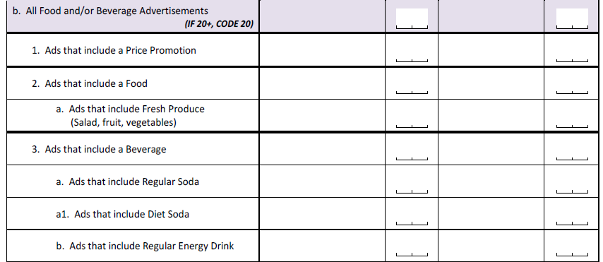
BTG-Comp Food Store Observation Form 2011

Slide 29
Preliminary Results: 2010 Data BTG-Comp Food Store Observation
K. OUTDOOR ADVERTISING
COUNT THE NUMBER OF… | K1. % of Outlets with Advertisements on Building Exterior |  | K2. % of Outlets with Advertisements on Property
b. All Food and/or Beverage Advertisements (IF 20+, CODE 20) | 55.7% |  | 30.2%
1. Ads that include a Price Promotion | 36.6% |  | 23.5%
2. Ads that include a Food | 37.6% |  | 13.2%
a. Ads that include Fresh Produce (Salad, fruit, vegetables) | 6.2% |  | 1.8%
3. Ads that include a Beverage | 42.9% |  | 24.3%
a. Ads that include Regular Soda | 21.3% |  | 17.3%
a1. Ads that include Diet Soda | New variable for 2011 Form
b. Ads that include Regular Energy Drink | 11.5% |  | 4.4%

Slide 30
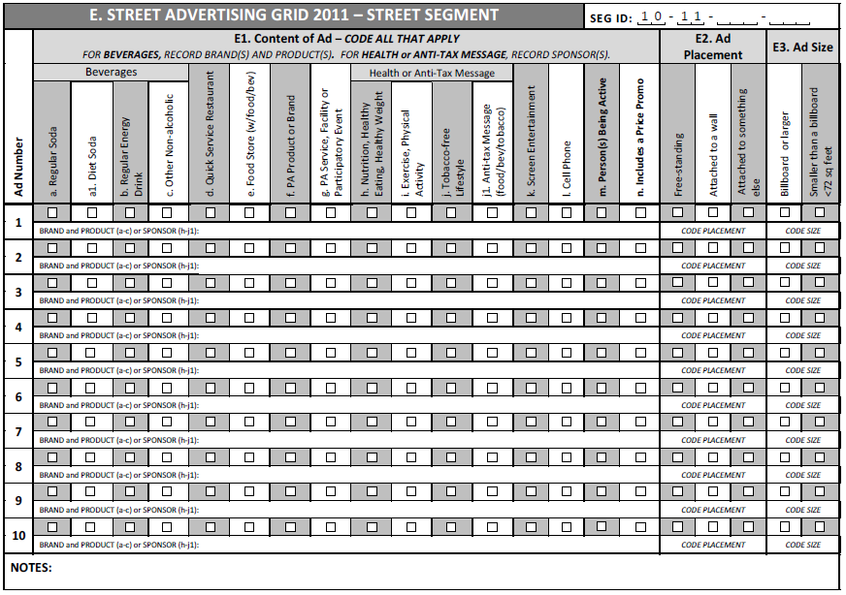
BTG-Comp: Street Advertising Grid 2011

Slide 31
BTG-Comp: Street Advertising Grid 2011
E1. Content of Ad |  | E2. Ad Placement |  | E3. Ad Size
Beverages a. Regular Soda a1. Diet Soda b. Regular Energy Drink c. Other Non-alcoholic |  | Free-standing |  | Billboard or larger
d. Quick Service Restaurant |  | Attached to a wall |  | Smaller than a billboard <72 sq feet
e. Food Store (w/food/bev) |  | Attached to something else
f. PA Product or Brand
g. PA Service, Facility or Participatory Event
Health of Anti-Tax Message h. Nutrition, Healthy Eating, Healthy Weight i. Exercise, Physical Activity j. Tobacco-free Lifestyle j1. Anti-tax Message (food/bev/tobacco)
Screen Entertainment
Cell Phone

Slide 32
Lisa Powell
powelll@uic.edu
ImpacTeen
http://www.impacteen.org
Bridging the Gap
http://www.bridgingthegapresearch.org

