Slide 1
Food Marketing and Childhood Obesity: The Rudd Center and Robert Wood Johnson Foundation
www.yaleruddcenter.org/marketing
Food Marketing Roundtable
Jennifer L. Harris
April 5, 2011

Slide 2
Project strategy
Objective
Reduce harm associated
with food marketing to youth
Rudd Center role
Understand and inform
Child and adolescent
exposure to food marketing
Impact of food marketing
exposure
Outcomes

Slide 3
Today
Update on Rudd Center research
Exposure
Impact
Outcomes

Slide 4
Exposure research
Product placements
Advergames
Ads on children’s 3rd-party websites
Ads on “child-targeted” vs. general audience TV
Ads viewed by Hispanic children on English- vs. Spanish-language TV

Slide 5
Impact of licensed characters
Popular cartoon characters on snack foods:
Increase preschoolers taste ratings of foods
Affect children’s choice of snack
Effects were weaker for carrots vs. fruit snacks and graham crackers
* Source: Roberto, Baik, Harris & Brownell, Pediatrics 2010.
Study to replicate findings with brand characters

Slide 6
Impact of sugared cereals
Serving children high-sugar vs. plain cereals:
Almost doubles amount of cereal consumed
Doubles refined sugar
Reduces fruit
No effect on total calories or milk
Children reported no differences in liking of cereal consumed
* Source: Harris, Schwartz, Ustjanauskas, Ohri-Vachaspati & Brownell. Pediatrics 2011.

Slide 7
Category effects
Associations between TV ad exposure and category consumption
ECLS-K and Nielsen spot market data
Exposure to carbonated beverage ads (incl. diet soft drinks)
▬► greater consumption of SSBs
Exposure to fast food ads
▬► greater consumption of fast food
▬► higher BMI for overweight and obese children
* Source: Andreyeva, Kelly & Harris. Economics and Human Biology, in press.

Slide 8
Impact of advergames
Playing unhealthy food advergames:
Increases nutrient-poor snack food consumed
Reduces fruit and vegetables consumed
Affects regular advergame players more
No age differences
Playing healthy food advergames:
Increases fruit and vegetables consumed
*Source: Harris, Speers, Schwartz & Brownell. Under revision.

Slide 9
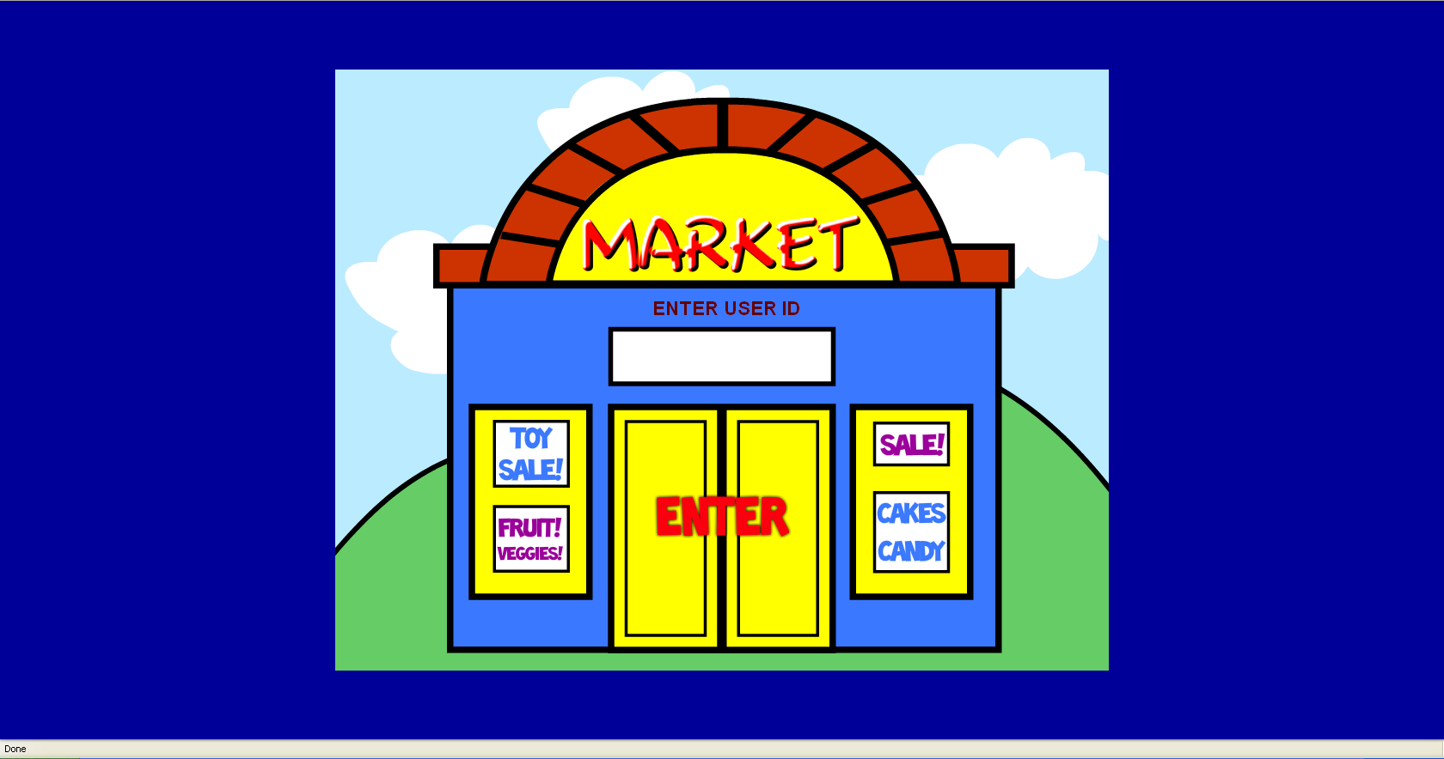
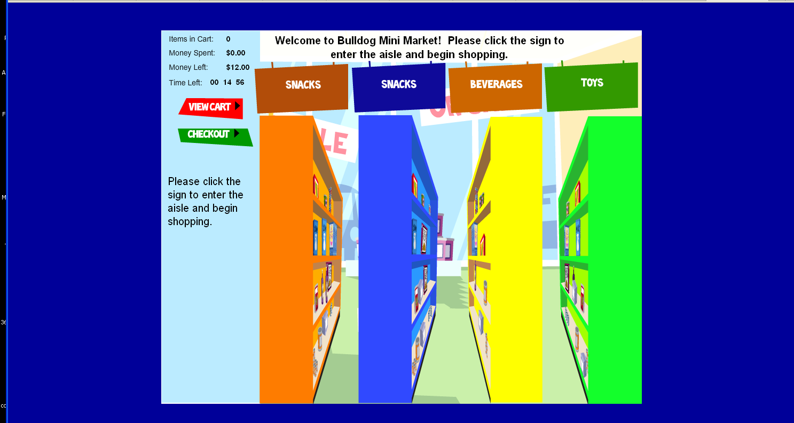
Measuring impact
Simulated supermarket “game”

Slide 10
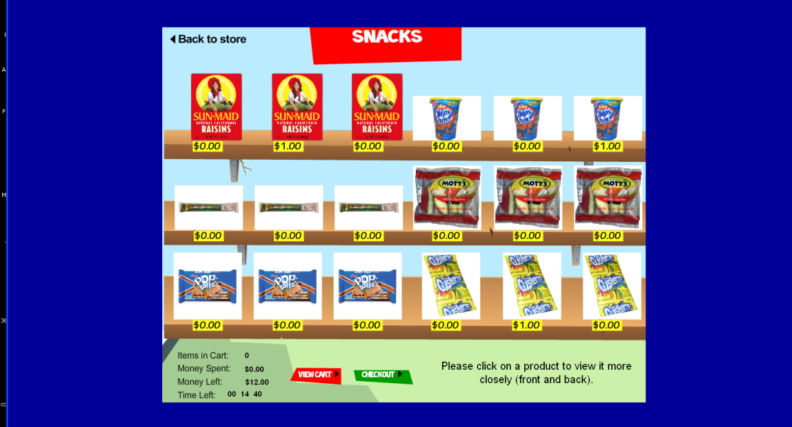
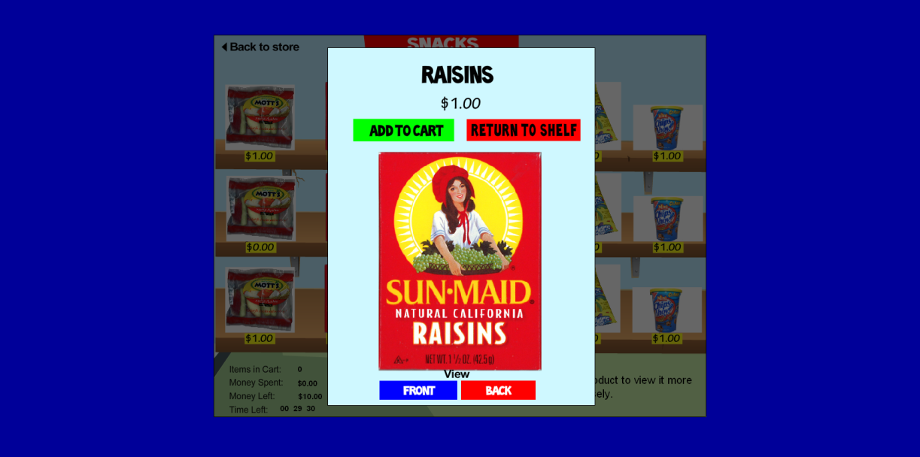
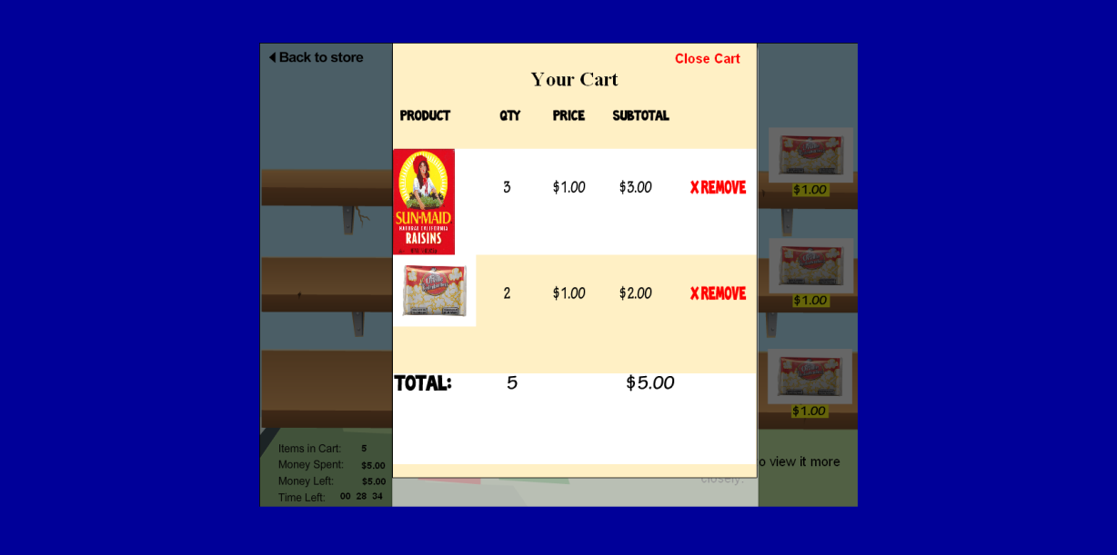
Measuring impact (cont’d)

Slide 11
Do parents care?
Concern about effects of media on children | 1-10
Sexual permissiveness | 7.7
Materialism | 7.6
Violence | 7.5 ↓0.3
Thin models | 7.3
Pester power | 7.3
Junk food advertising to children | 7.1
Encourage bad eating habits | 7.1
Alcohol use | 7.1
Tobacco use | 6.9
Advertising in general | 6.8
Gender stereotypes | 6.7
Racial/ethnic stereotypes | 6.6
Source: Rudd Center opinion tracking survey, 2010

Slide 12
Changing public opinion
2-step process:
Awareness of unhealthy marketing
.11***
Perceived negative impact
.53***
Support for marketing restrictions
.01 (ns)
Source: Goren, Harris, Schwartz & Brownell. Health Affairs 2010

Slide 13
Impact of Cereal FACTs
Results were “news”
Exclusives in Time magazine and ABC News
Covered in USA Today, AP, LA Times, Chicago Tribune, Fox, NBC, CBS
41,000+ unique visitors to cerealfacts.org

Slide 14
Impact (cont’d)
Cereal companies paid attention
Kellogg discontinued immunity claim (one week later)
General Mills PR campaign to promote “benefits of cereal”
PepsiCo discontinued Cap’n Crunch child-targeted website
General Mills, Kellogg and Post Safe Space meetings
General Mills and Post announced plans to reduce sugar in children’s cereals
General Mills discontinued Millsberry advergames

Slide 15
Thank you
My collaborators:
Marlene B. Schwartz | Amy Ustjanauskas
Kelly D. Brownell | Christina Munsell
Vishnudas Sarda | Andrew Cheyne
Megan E. Weinberg | Lori Dorfman
Johanna Richardson Sarah Speers | Christina Roberto Tatiana Andreyeva
Jackie Thompson Amir Goren | Punam Ohri-Vachaspati
Our distinguished Steering Committee members
Tracy Orleans and our supporters at The Robert Wood Johnson Foundation

Slide 16
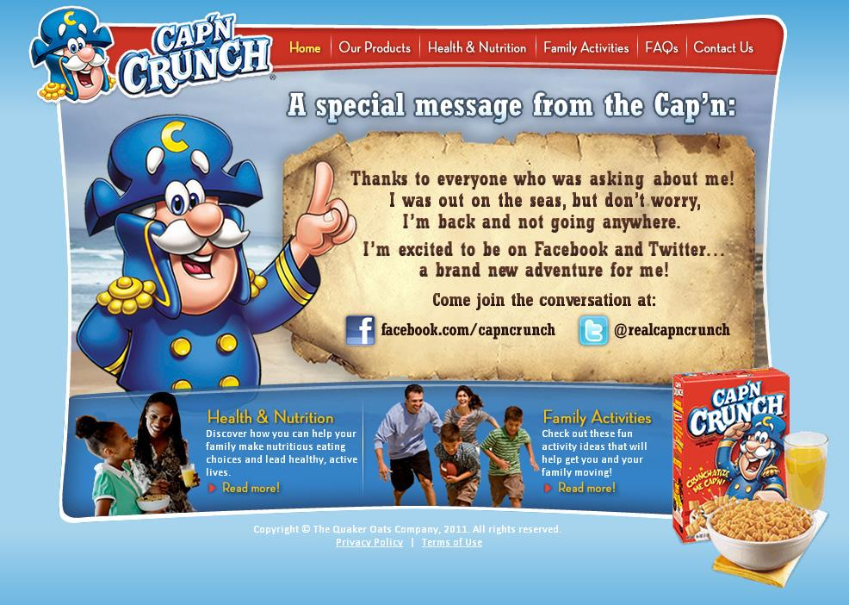
Importance of framing

Slide 17
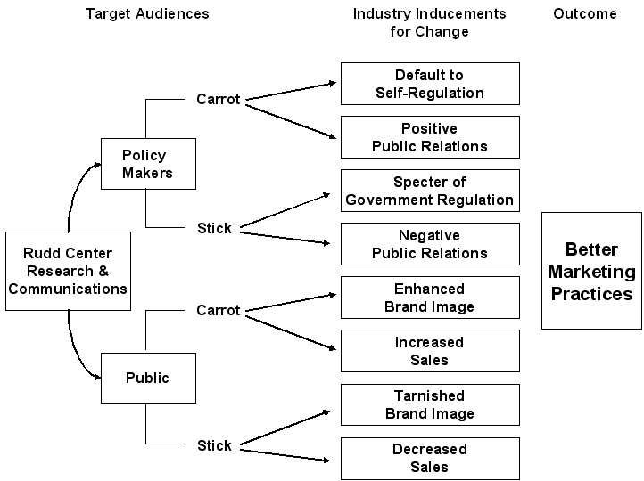
Model of industry change

Slide 18
Focus groups with parents
“If these are better-for-you foods, what’s the worst list?”
“I don’t think anything has changed. I could name 30 commercials: Cookie Crisp, Fruity Pebbles, Cocoa Puffs… same regular old commercials.”
“It’s a lie.” (nutrition claims)
“If we don’t get the companies to know that we are unhappy… they aren’t going to change anything.”
“The art of manipulation. Like drugs for kids.” (Postopia website)
Source: Ustjanauskas et al., 2010

Slide 19
Framing the issue
Food marketing undermines parental authority
Why should food companies be allowed to make parents’ jobs more difficult?
Not about,
Limiting choices
Regulating sale of foods

