Slide 1
Examining the Relationship Between Childhood Obesity and the Food and Physical Activity Environments
Punam Ohri-Vachaspati, PhD, RD
Arizona State University
Collaborators: Kristen Lloyd, MPH;
Derek DeLia, PhD; David Tulloch, PhD;
Michael Yedidia, PhD

Slide 2
Presenter Disclosures
Punam Ohri-Vachaspati
No relationships to disclose

Slide 3
Outline
Disparities in access to food and PA opportunities
Food and PA environments and children’s weight outcomes
Current study
Objectives
Design
Analysis
Results
Conclusions

Slide 4
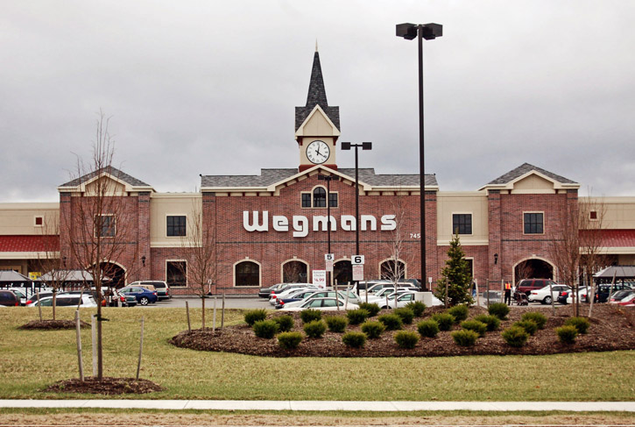
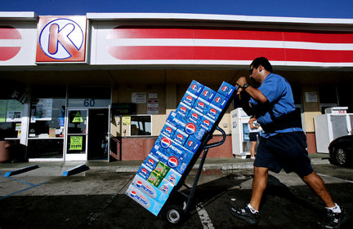
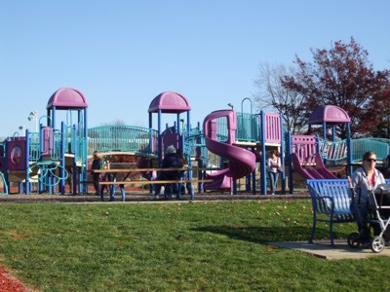
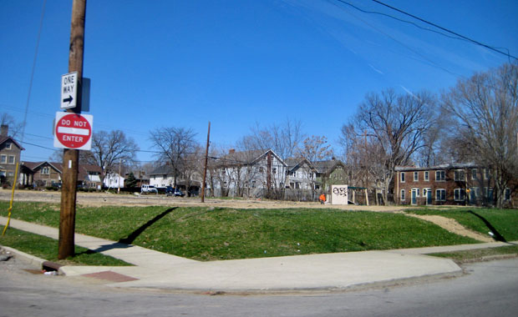
Disparities in Access to Healthy Food and PA Opportunities
Lower Income & Communities of Color
Higher Income & Less Diverse Communities
Preponderance of unhealthy options
Easier access to supermarkets
Limited PA opportunities
Better access to PA opportunities
Zenk et al, 2006; Morland & Filomena, 2007; Kipke et al. 2007; Sturm, 2008, Larson et al. 2009
Notes:
These findings have lead to policy recommendations (from the IOM, CDC, the White House task force among others) for improving access to healthy foods in underserved area and limited access to unhealthy options, similar recommendations for PA environments have been made.

Slide 5
Inconsistent Findings of Relationship Between Food Access and Childhood Obesity
Positive Associations
Availability of supermarkets associated with lower BMI (Powell et al, 2007)
Proximity to LSR associated with higher BMI (Davis and Carpenter, 2009; Mellor et al, 2011)
Proximity to convenience store associated with higher BMI (Galvez, 2008; Laska et al. 2010; Leung et.al. 2011)
Lack of Association
Any type of food environment (An and Sturm, 2012; Lee 2012)
Specific types of food environments (Laska et al. 2010; Leung et.al. 2011; Howard et al. 2011)
Notes:
Specifics about each study (eg what age, where etc)

Slide 6
Inconsistent Findings of Relationship Between PA Opportunities and Childhood Obesity
Positive Associations
PA facilities and parks associated with reduced risk of overweight or obesity
(Gordon-Larsen, 2006; Wolch et al. 2011)
Lack of Associations
No association between proximity to parks and PA facilities
(Burdette and Whitaker, 2004; Kligerman et al 2007)
Notes:
Specifics about each study

Slide 7
Potential Reasons for Conflicting Results
Different age groups investigated
Study of either food OR PA environment
Variations in the geographic characteristics of the environment studied
Variation in types of measurements used
Notes:
Have an example for each

Slide 8
Objectives
Using data from four urban, low-income, racially diverse cities in NJ this study investigates the role of food and PA environments by considering a variety of potentially important measures of proximity and assesses the association between weight status of children in a broad spectrum of age groups.

Slide 9
Study Design – Data Sources
Household survey (2009-2010) of 1408 households in 4 NJ cities (Camden, Newark, New Brunswick, Trenton)
Households with children ages 3-18 yrs
Demographic characteristics of household and neighborhood
Geo-coded location of residence
Respondent measured weights and heights
GIS data on food and PA outlets – food outlets classified using a standardized methodology (Ohri-Vachaspati, 2010)

Slide 10
Study Design - Measures
Outcome: Dichotomized indicator of child weight status
Exposure: proximity to food and PA outlets to each child’s residence
Presence in varying radii (¼ mile, ½ mile, 1 mile)
Roadway network distance to the nearest outlet
Counts of food and PA outlets in varying radii (¼ mile, ½ mile, 1 mile)
Control variables: Demographics, parent BMI, neighborhood SES

Slide 11
Analysis
Bivariate associations between exposure and outcome
Multivariate logistic regression to assess the association controlling for demographic variables and parent BMI
Data weighted to be representative of 3-18 year olds in the four study cities
Analysis adjusted for complex survey design

Slide 12
Results
Demographic and Neighborhood Characteristics of Children
and Associations with Weight Status
(unweighted n =702)
Characteristic | % or Mean (SE)^{b}
Child: Overweight or obese (≥ 85th percentile) | 38.1 (2.5)
Child Age** 2-5 yrs 6-11 yrs 12-19 yrs | 15.7 (1.8) 40.6 (2.2) 43.7 (2.5)
Child: Female | 48.8 (2.4)
Child Race/Ethnicity** Non-Hispanic white Non-Hispanic black Hispanic Other race | 7.1 (1.8) 47.8 (3.2) 40.1 (3.1) 5.0 (1.5)
^{b} Sample weighted and SE adjusted for complex survey design
*p<0.10 in bivariate logit model with child’s weight status
**p<0.05 in bivariate logit model with child’s weight status

Slide 13
Results
Demographic and Neighborhood Characteristics of Children
and Associations with Weight Status
(unweighted n =702)
Characteristic | % or Mean (SE)^{b}
Parent: Foreign-born** | 31.4 (3.0)
Household: Non-English* | 27.0 (2.7)
Household: ≤ 200% of poverty line | 80.5 (2.2)
Mother’s education* High school or less Some college College graduate or higher | 58.7 (3.2) 26.2 (2.8) 15.1 (2.4)
Parental BMI ** | 30.0 (0.5)
Median Income in Block Group** | $35,746 ($925)
Race/Ethnicity: Percentage in Block Group Non-Hispanic black Hispanic Other race | 49.5 (2.1) 35.4 (1.6) 3.8 (0.3)
^{b} Sample weighted and SE adjusted for complex survey design
*p<0.10 in bivariate logit model with child’s weight status
**p<0.05 in bivariate logit model with child’s weight status

Slide 14
Results
Distributions of Objective Measures of Neighborhood Food and Physical Activity Environment
FOOD ENVIRONMENT GEOSPATIAL VARIABLES | % or Mean (SE)^{b}
PA ENVIRONMENT GEOSPATIAL VARIABLES | % or Mean (SE)^{b}
Miles to nearest Supermarket Small Grocery store Convenience store Fast-food restaurant | 0.72 (0.02) 0.48 (0.02) 0.18 (0.01) 0.21 (0.01)
Presence in ¼ mile radius^{d} Supermarket Small Grocery store Convenience store Fast-food restaurant | 11.5 (2.4) 26.1 (3.0) 82.9 (2.2) 68.5 (2.9)
Miles to nearest Park (1 acre or more) PA facility | 0.28 (0.01) 0.71 (0.03)
Presence in ½ mile radius^{d} Park (≥ 1 acre) PA facility | 88.8 (2.4) 37.2 (3.0)
^{b} Sample weighted and SE adjusted for complex survey design
^{d} Radius measurement based on road distances

Slide 15
Results
Distributions of Objective Measures of Neighborhood Food and Physical Activity Environment – some have no variability
FOOD ENVIRONMENT GEOSPATIAL VARIABLES | % (SE)^{b}
PA ENVIRONMENT GEOSPATIAL VARIABLES | % (SE)^{b}
Presence in 1 mile radius^{d} Park (≥ 1 acre) PA facility | 100.0 (--) 78.4 (2.8)
Presence in 1 mile radius^{d} Supermarket Small Grocery store Convenience store Fast-food restaurant | 80.1 (1.8) 90.9 (1.6) 98.9 (0.5) 99.8 (0.1)
^{b} Sample weighted and SE adjusted for complex survey design
^{d} Radius measurement based on road distances

Slide 16
Results
Bivariate Association Between Objective Measures of Neighborhood Food and Physical Activity Environment and Child’s Weight Status (Unweighted sample size = 702)
Geospatial variable | Unadjusted OR of Being OW/OB (95% CI)^{b}
Miles to nearest Supermarket Small Grocery store Convenience store Fast-food restaurant | 1.12 (0.76, 1.66) 0.70 (0.41, 1.18) 0.18 (0.05, 0.63)** 0.47 (0.13, 1.69)
Presence in ½ mile radius^{d} Supermarket Small Grocery store Convenience store Fast-food restaurant | 0.82 (0.52, 1.29) 1.08 (0.70, 1.67) 3.54 (1.14, 10.98)** 2.46 (0.99, 6.16)*
Presence in ¼ mile radius^{d} Supermarket Small Grocery store Convenience store Fast-food restaurant | 0.55 (0.26, 1.17) 0.96 (0.59, 1.56) 1.99 (1.15, 3.45)** 0.83 (0.52, 1.30)
Number of outlets in ¼ mile radius^{e} Supermarket Small Grocery store Convenience store Fast-food restaurant | 0.61 (0.33, 1.10) 1.03 (0.83, 1.27) 1.09 (1.00, 1.20)* 1.01 (0.95, 1.08)
Presence in ½ mile radius^{d} Park (1 acre or more) PA facility | 0.36 (0.18, 0.75)** 0.85 (0.55, 1.31)
^{b} Sample weighted and SE adjusted for complex survey design
^{d} Radius measurement based on road distances
^{e} Radius measurement based on shortest distance between two points
*p<0.10 in bivariate logit model with child’s weight status
**p<0.05 in bivariate logit model with child’s weight status

Slide 17
Results
Multivariate logistic regression analysis of the association of proximity to elements of the food and physical activity environment with child’s weight status
Key Geospatial Predictor(s)ª | Adjusted OR of Being OW/OB (95% CI)^{b}
Distance to nearest (miles) Convenience store | 0.33 (0.08-1.36)
Presence in ½ mile radius Convenience Store Fast-Food Restaurant Park (1 acre or more) | 1.41 (0.34-5.72) 1.42 (0.48-4.24) 0.45 (0.24-0.86)**
Presence in ¼ mile radius Convenience store | 1.82 (1.01-3.28)**
Number in ¼ mile radius Convenience store | 1.11(1.00-1.22)**
ªMultivariate regressions were run for geospatial variables having a significant (p<0.1) bivariate association with child’s weight status
^{b} Sample weighted and SE adjusted for complex survey design; Each model controlled for child’s age, race/ethnicity, parental nativity, mother’s education level, household language status, parental BMI, and median income in the block group of child’s residence.
**p<0.05

Slide 18
Summary
Children living within a ¼ mile of a convenience stores have almost twice the odds of being overweight of obese
Children living within a ½ mile of a park have less than half the odds of being overweight of obese

Slide 19
Implications for Methodology
Are the measures of proximity meaningful for the locales under study?
Do the areas under study have similar geospatial landscape?
Does the ubiquity of outlets make it difficult to observe associations?

Slide 20
Conclusion
Living in close proximity to convenience stores and parks may influence weight outcomes in children 3-18 years old
It is important to select measures of proximity that are suited to the geospatial landscape of community under study

Slide 21
Supported by a grant from
The Robert Wood Johnson Foundation

Slide 22
Thank You!
Contact information:
Punam.Ohri-Vachaspati@asu.edu

